Slide 1
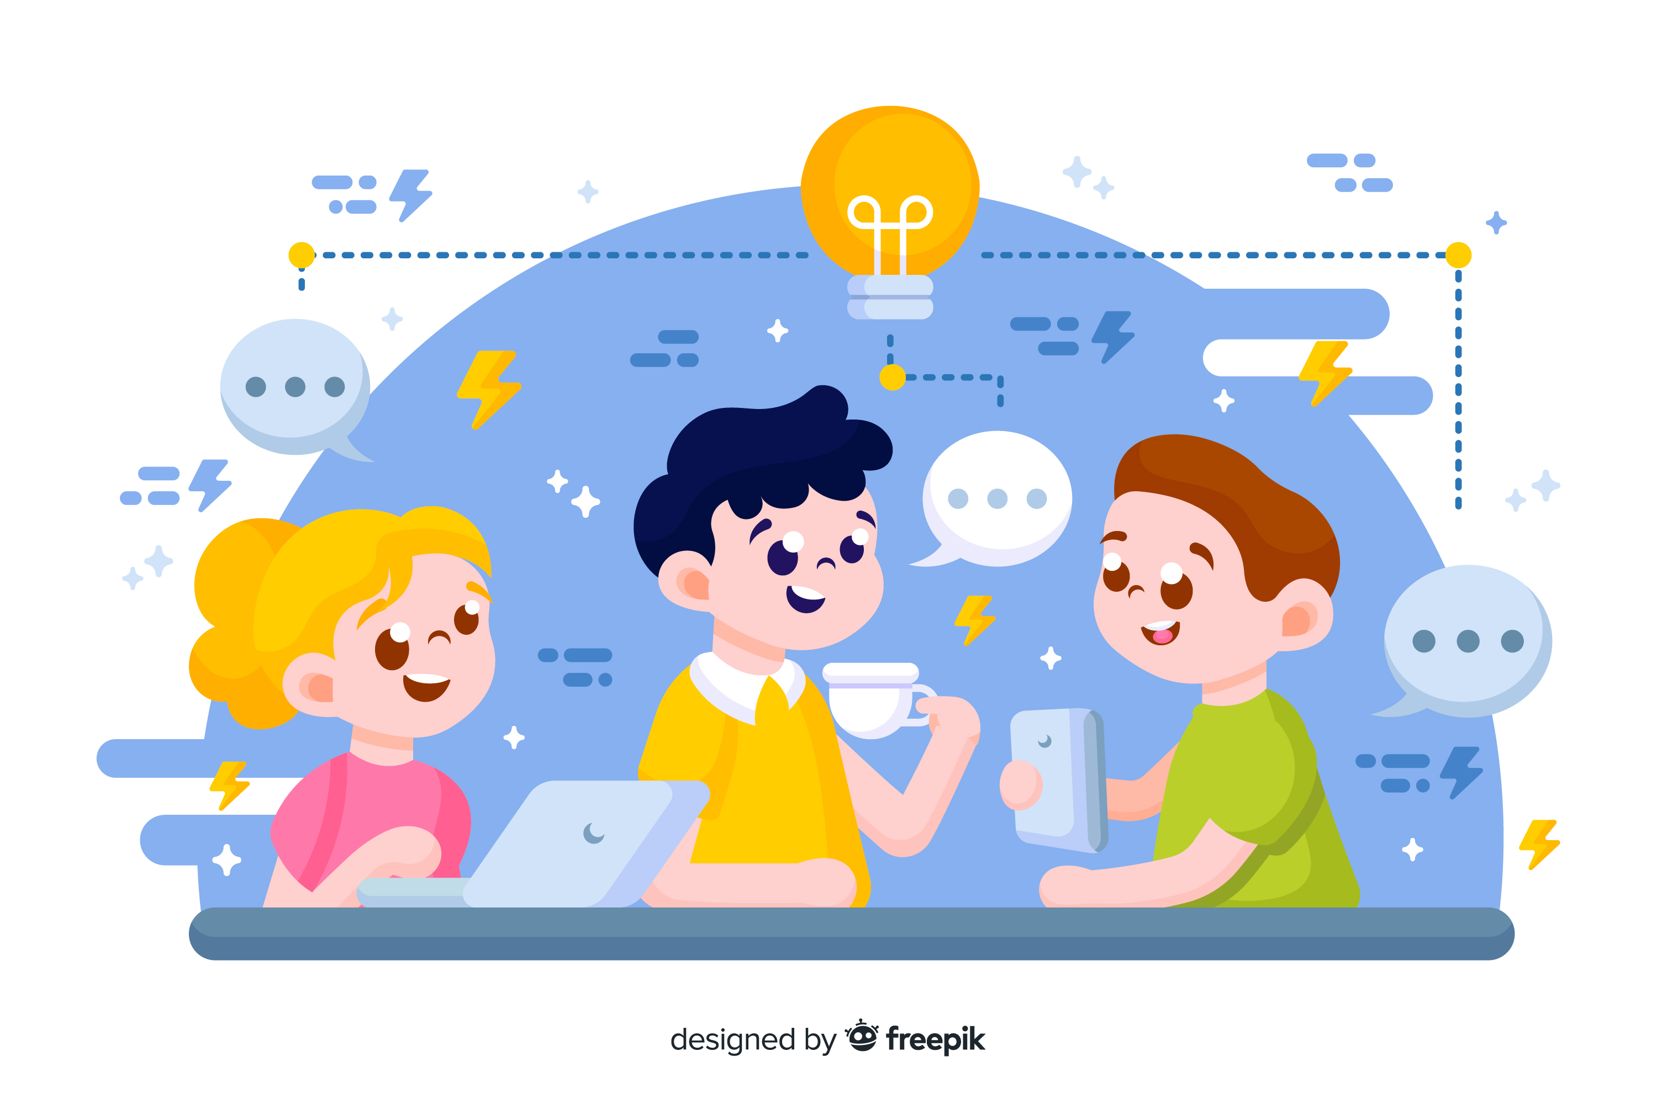
Learn Programming For Kids (Python)

Slide 2
Lesson 9
OOPs in Python

Slide 3
12. OOPs in Python
OOPs is a concept that is used in industry to reusability and security of the code. In the beginning, you can skip this concept If you are a kid, but If you are interested in learning deep with Python then you are good to go.

Slide 4
Imagine you have a big box of Lego blocks. Each block has its own shape, color, and purpose. OOP is like playing with Lego blocks, but with a twist!
In regular programming, we write instructions step by step to tell the computer what to do. But with OOP, we think about our program like a world filled with different objects that interact with each other.

Slide 5
Components in OOPS

Slide 6
Class:
A class is like a blueprint or a template that defines the characteristics (attributes) and behaviors (methods) of an object.

Slide 7
For example, consider a “Dog” class that defines how a dog should behave and what it can do. Think of a “Dog” class as a blueprint for different dog breeds. Each breed of dog (e.g., Labrador Retriever, Poodle, etc.) can be represented as an object of the “Dog” class.

Slide 8
Objects:
An object is an instance of a class. It represents a specific entity that has its own unique set of attributes and can perform actions.

Slide 9
For example, a specific dog like “my_dog” is an object of the “Dog” class. “my_dog” can be an object representing an actual dog, such as “Bravo” which has its own attributes (e.g., name, breed, age) and can perform actions (e.g., bark, eat, fetch).

Slide 10
Methods:
A method is a function associated with an object that defines the actions or behaviors it can perform.

Slide 11
For example, a dog object can have methods like “bark()” or “eat()”. A dog object can have methods such as “bark()” to make a sound or “eat()” to consume food.

Slide 12
OOPs Concepts in Python

Slide 13
OOP is an important concept in Python that makes programming more fun and efficient, just like playing with building blocks. Here are some simplified explanations of Python’s Object-Oriented Programming (OOP) concepts for kids, along with real-world examples:

Slide 14
1. Inheritance:
Inheritance is like passing down traits from parents to children. Just like you inherit traits from your parents, objects can inherit traits and behaviors from other objects. For example, think of a superhero. They may have special powers like flying or super strength. Now, imagine a new superhero is created. They can inherit those special powers from the existing superheroes and have their own unique powers too. In programming, we can create new objects that inherit properties and behaviors from existing objects, allowing us to reuse and extend what already exists.

Slide 15
2. Encapsulation:
Imagine you have a treasure box. It keeps your precious things safe and hidden. Encapsulation in programming is like that treasure box. It helps us keep related things together, just like you keep your toys in a box. We put data (like attributes) and actions (like methods) inside an object, and the object keeps them safe. This way, we can control how they are accessed and make sure they are used correctly.

Slide 16
3. Polymorphism:
Polymorphism is like having a magic wand that can turn into different things when you need it. In programming, it means that objects can take on different forms and do different things based on the situation. For example, think of a pet. A pet can be a dog, a cat, or a bird. They all have different sounds and behaviors, but we can treat them all as “pets” and play with them. Similarly, in programming, we can have different objects that share a common behavior or interface, but they can behave differently when needed.

Slide 17
4. Data Abstraction:
Abstraction is like having a remote control to operate a complicated machine. Instead of worrying about the inner workings of the machine, you can use the remote to control it easily. In programming, abstraction helps us hide unnecessary details and focus on what’s important. We can create simplified interfaces that allow us to interact with objects without worrying about how they work internally. For example, think of a music player. You don’t need to understand how it plays music; you just need to press the play button to enjoy your favorite songs.

Slide 18
These concepts of OOP help us organize, simplify, and make our programs more flexible. Encapsulation keeps things organized and safe, polymorphism allows objects to behave differently when needed, inheritance helps us reuse and extend existing code, and abstraction lets us focus on what’s important without worrying about the details. Together, they make programming more fun and efficient, just like using your imagination to create new things and play with them.

